Slide 1
Deliverable 3
Adam Afilaka: Developer/Programmer
Ashley Braun: Business Analyst/Project Manager
Zaid Islam: Cyber Security Engineer
Rithika Sayini: Researcher/Programmer
Shanese Scott: Database Administrator
Xin Zheng: Quality Assurance

Slide 2
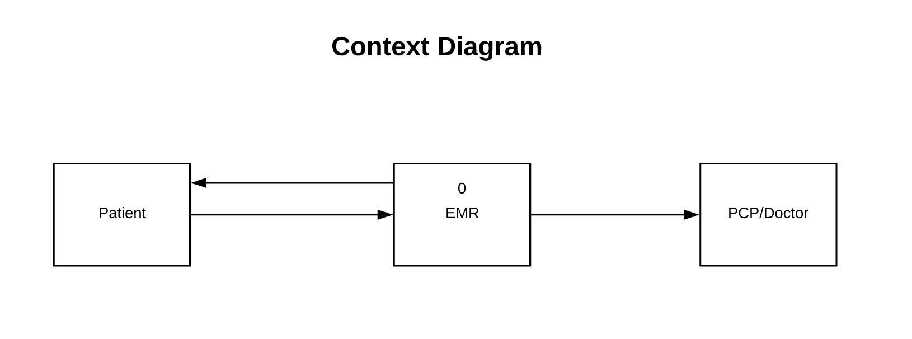
Context Diagram

Slide 3
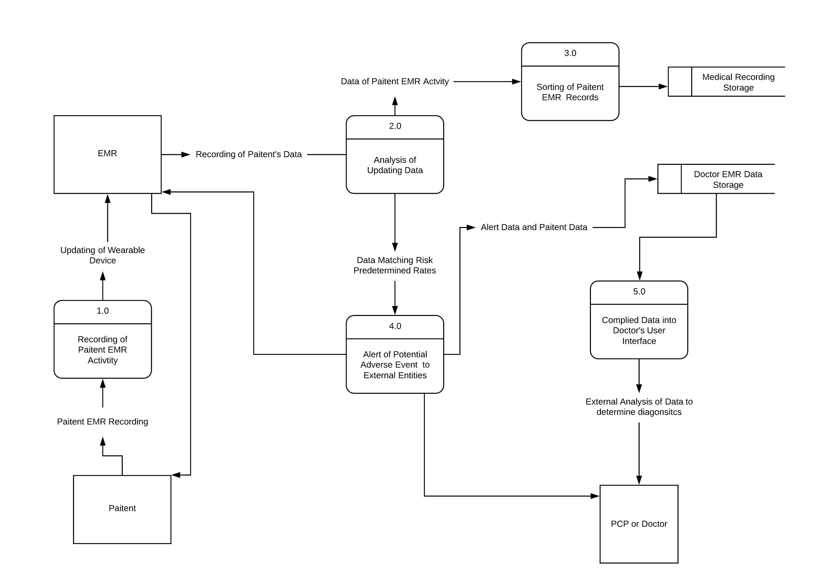
Level 0
External Entities
Patient:
EMR:
Doctor:
Processes:
1.0: Recording of Data Activity:
2.0: Analysis of Updating Data:.
3.0: Sorting of Patient EMR Records:
4.0: Alert of Potential Adverse Event:
5.0: Compiled Data into User Interface:
Data Storages
Medical Recording Storage:.
Doctor EMR Data Storage:

Slide 4
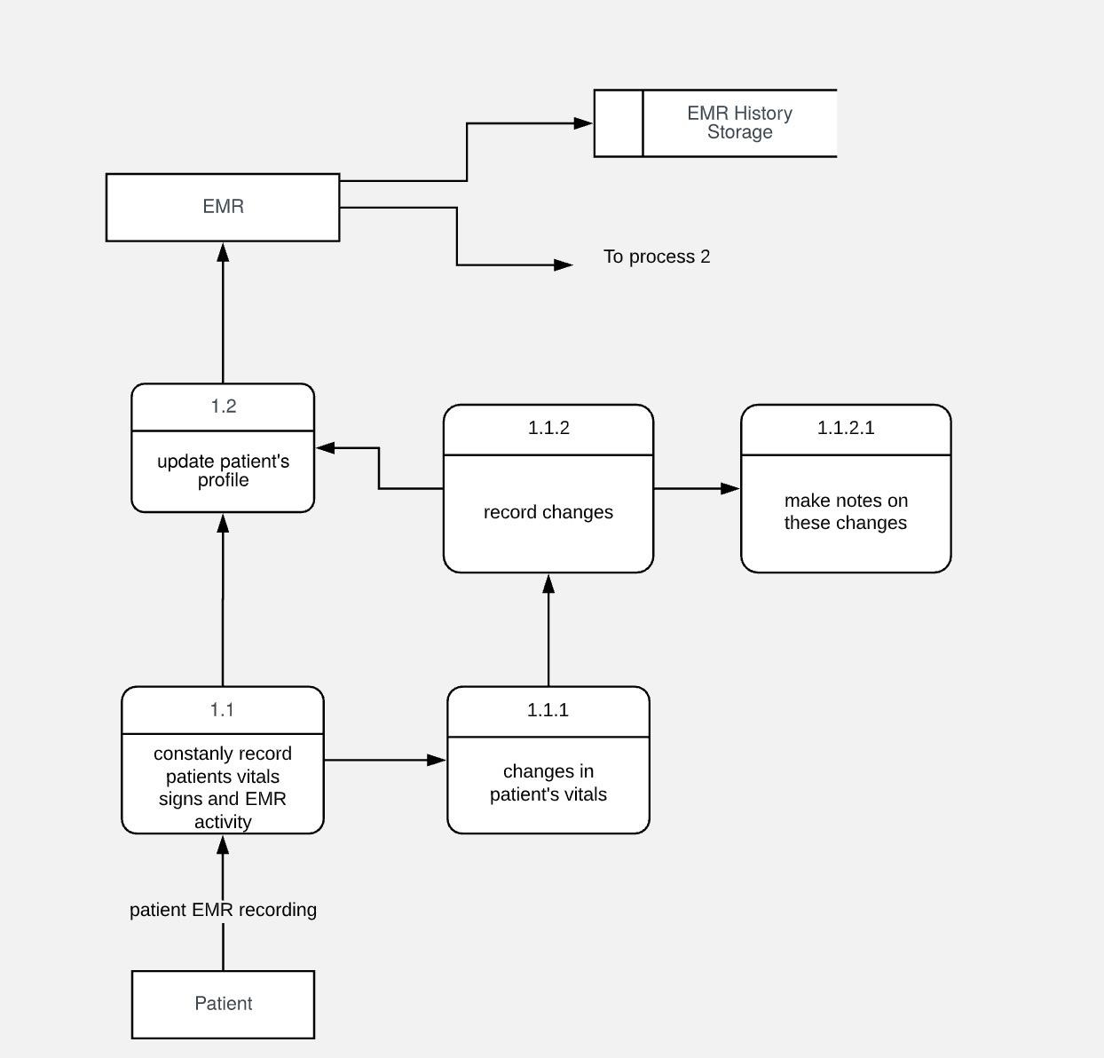
Process 1- Recording of Patient EMR Activity
External Entities: Patient, EMR
Levels:
Level 1: 1.1, 1.2
Level 2: 1.1.1, 1.1.2,
Level 3: 1.1.2.1
Storage: EMR database storage

Slide 5
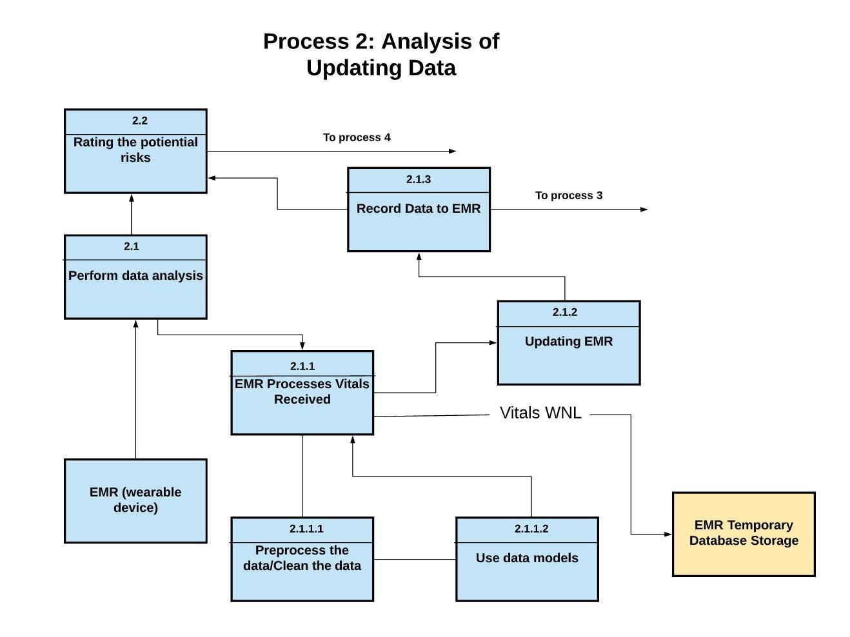
Process 2-Analysis of Updating Data
External Entities: EMR
Levels
Level 1: 2.1, 2.2
Level 2: 2.1.1, 2.1.2, 2.1.3
Level 3: 2.1.1.1, 2.1.1.2
Storage: EMR database storage

Slide 6
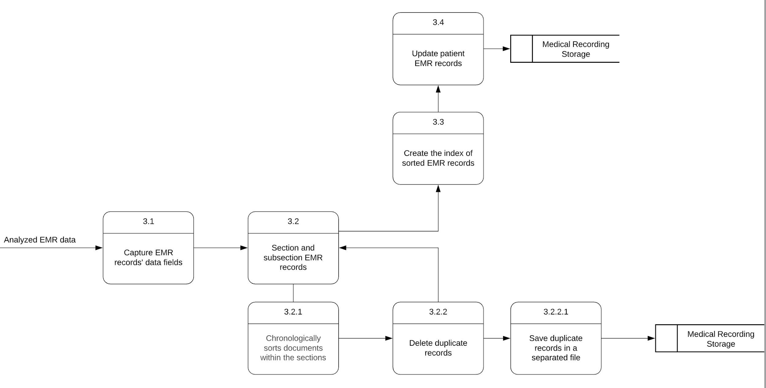
Process 3- Sorting of Patient EMR Records
External Entities: None
Levels
Level 1: 3.1,3.2, 3.3, 3.4
Level 2: 3.2.1,3.2.2
Level 3: 3.2.2.1
Data Storages:
Medical Recording Storage

Slide 7
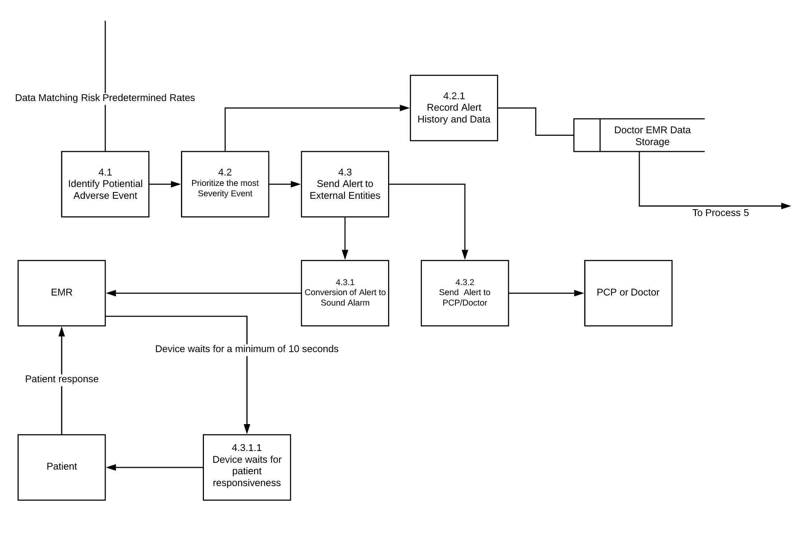
Process 4-Alert of Potential Adverse Event to External Entities
External Entities:
EMR, PCP/Doctor, Patient
Levels:
Level 1: 4.1, 4.2, 4.3, 4.4
Level 2: 4.2.1, 4.3.1, 4.3.2
Level 3: 4.3.1.1
Data Storages:EMR History Storage

Slide 8
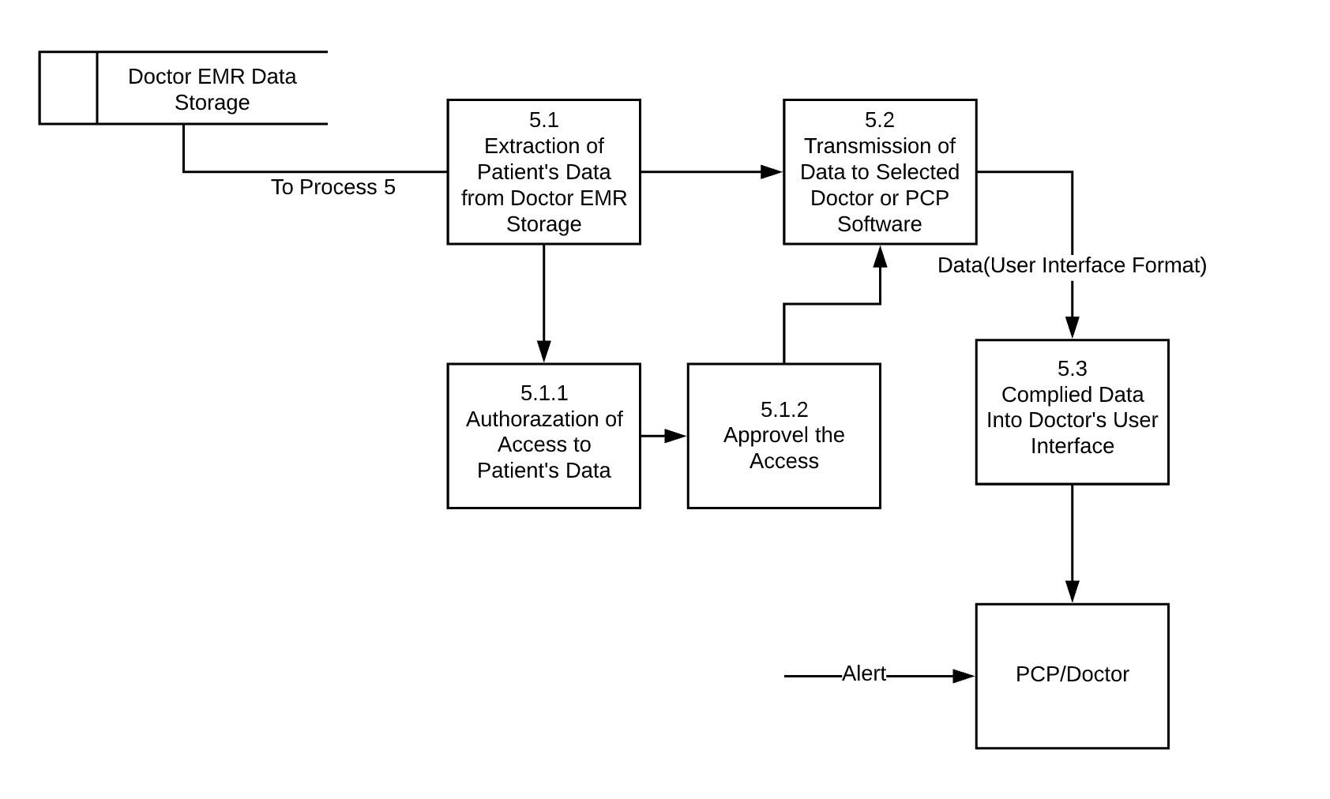
Process 5- Compiled Data into Doctor’s User Interface
External Entities:
PCP/Doctor
Levels:
Level 1: 5.1, 5.2, 5.3
Level 2: 5.1.1, 5.1.2
Data Storages:
Doctor EMR Data Storage

Slide 9
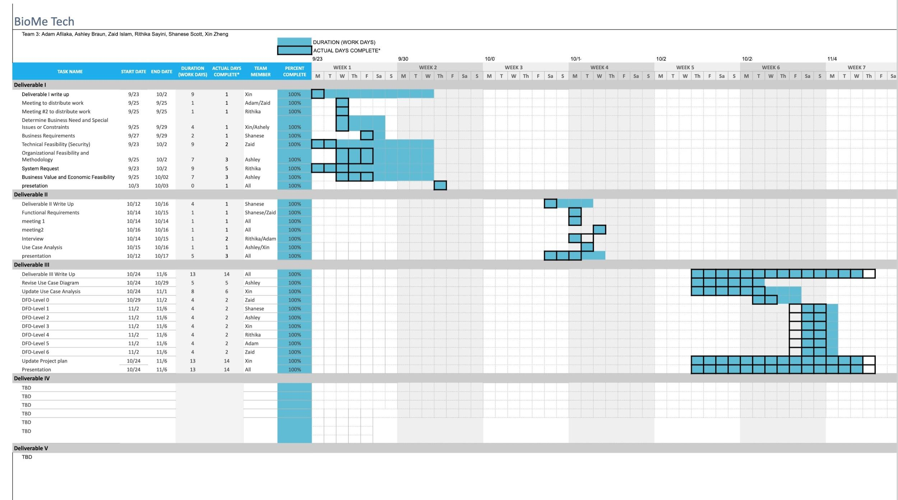
Project Plan

Slide 10
Deliverable 4

Slide 11
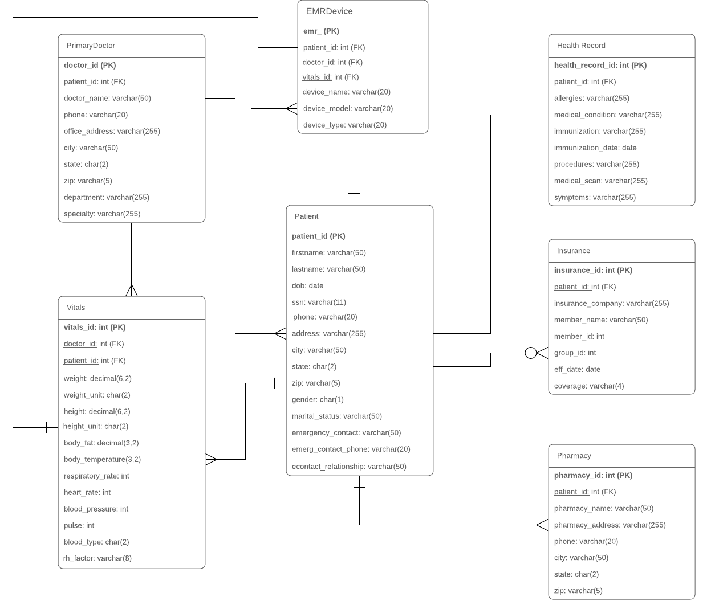
ERD
Patient has a relationship with every table in the ERD. Each patient has at least one pharmacy. Each patient has one health record. Each patient can have multiple forms of insurance.
Each EMR is connected to one patient and records the vitals of that one patient. The primary doctor is the only one who should have access to the EMR data.
The primary doctor can also have multiple patients, but the patient can only have one primary doctor that has access to their data.

Slide 12
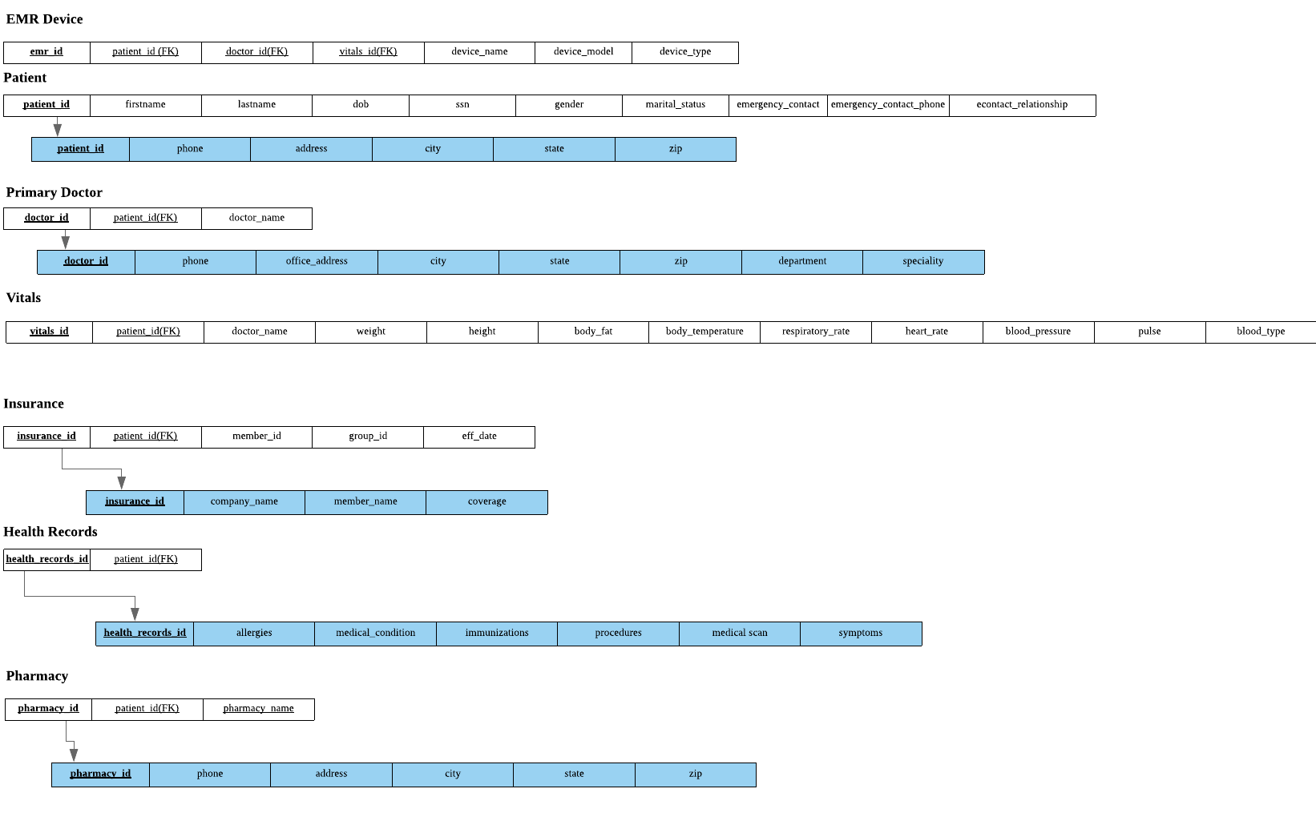
3NF

Slide 13
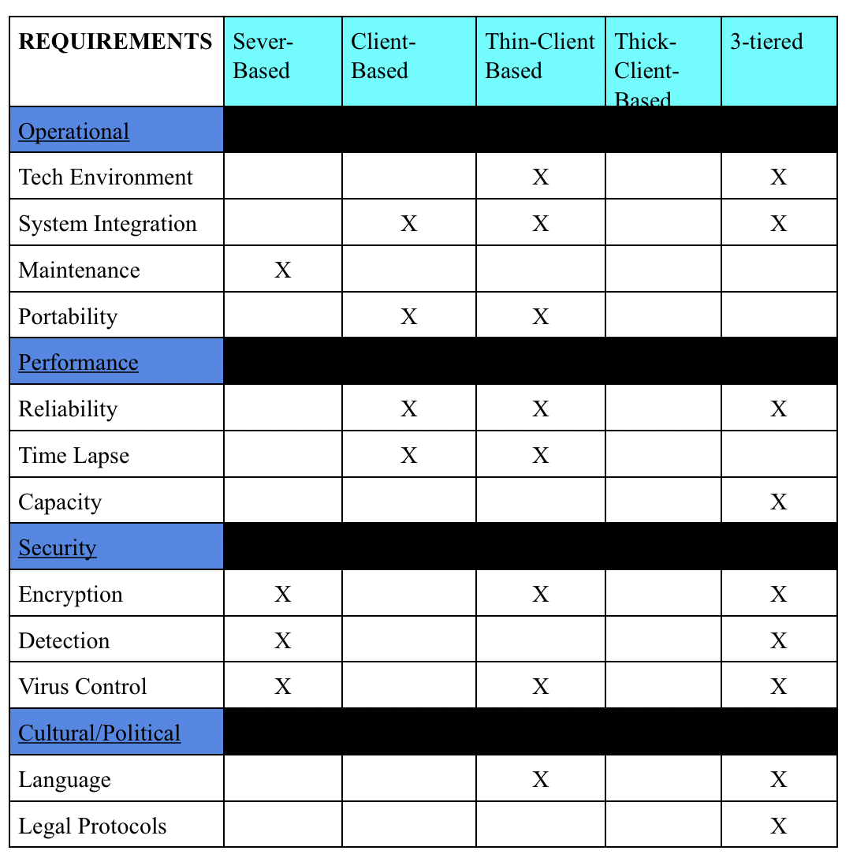
Architectural Design Matrix

Slide 14
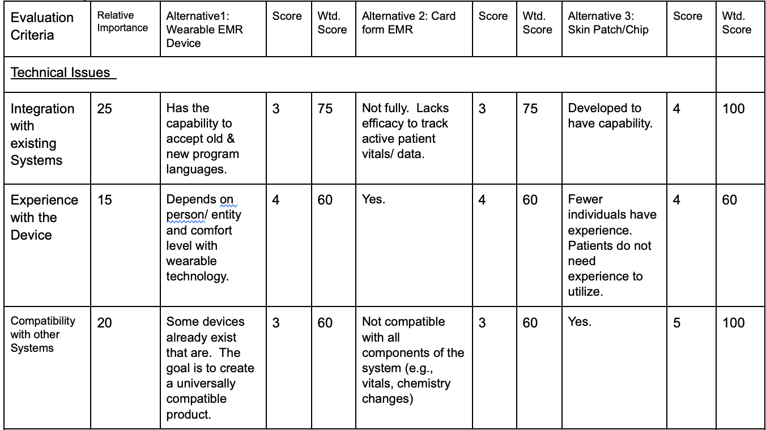
Team Matrix

Slide 15
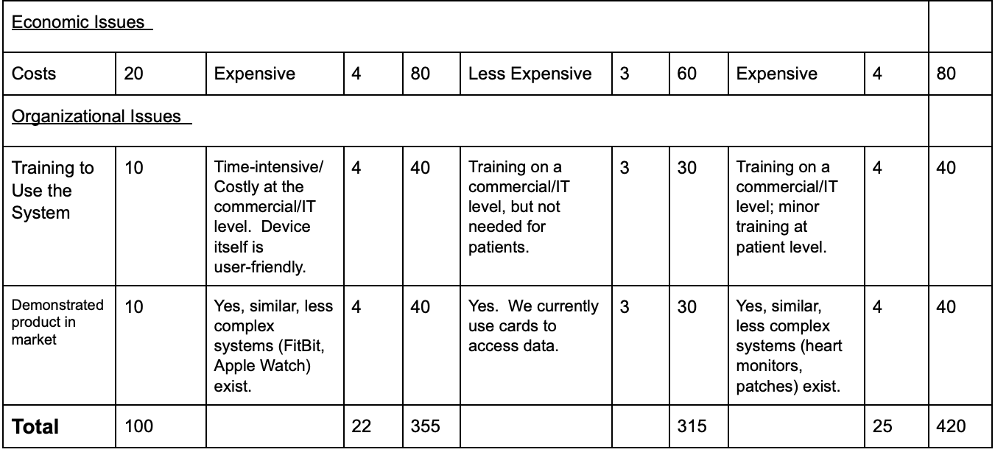
Team Matrix Con’t

Slide 16
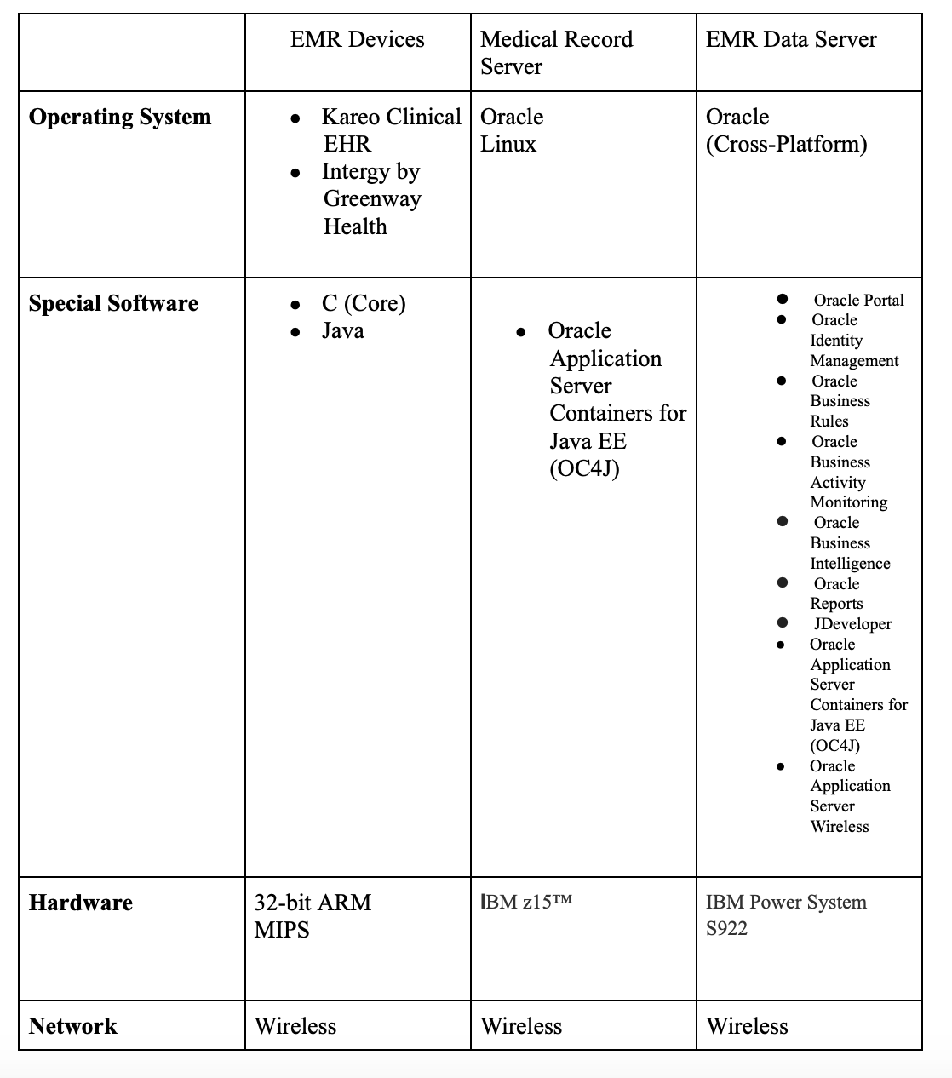
Hardware and Software Specifications

Slide 17
Group Integration
Using the system to assist with existing electronic medical record systems, EMRs, to be backed up to the cloud to manage patient records
Document control solution (document management solution) for inhouse records to be put in a cloud environment
Using network drives, to make that switch to a cloud based data storage instead of using local storage
Common data format

Slide 18
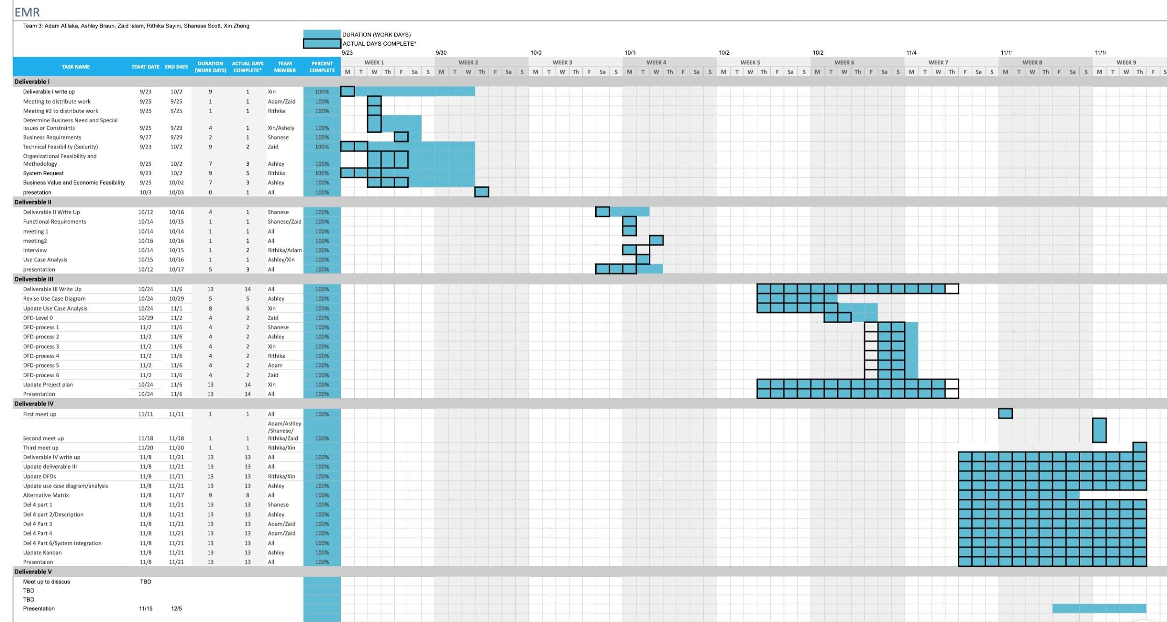
Project Plan

Slide 19
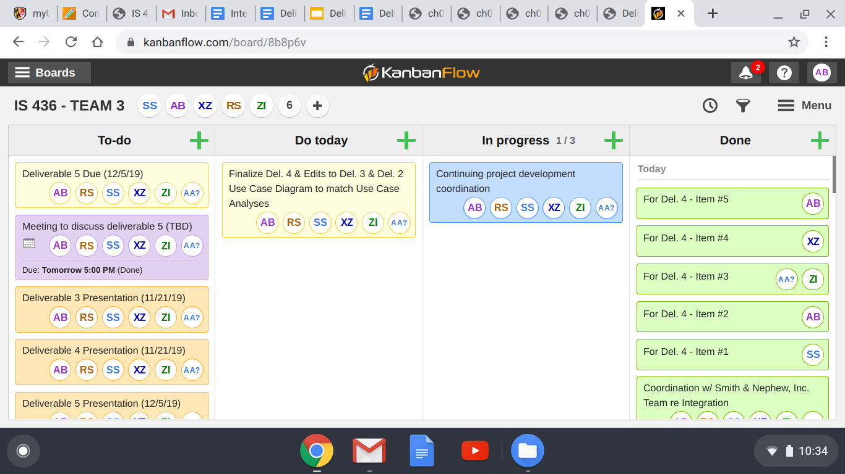
Kanban Board

